Slide 1
Simple Artistic Toolset
Daniel Leblanc

Slide 2
Initial Plan
Implement two papers and combine the results
Painterly Styles
Salient Preserving Greyscale Transformation

Slide 3
Updated Plan
Implement three papers and combine the results
Extended Difference of Gaussian
Painterly Styles
Salient Preserving Greyscale Transformation

Slide 4
Project Warm-up
Image Thresholding
Simple Greyscale conversion
Inverting an Image
Gaussian Blur
Median Filter
Equalizing Histograms
Image tiling

Slide 5
XDoG
Implement this with a variety of parameters
Black and White images
Three-tone greyscale
Edge sharpening on the original Image
Currently Implemented
Just a simple two-tone difference of Gaussian

Slide 6
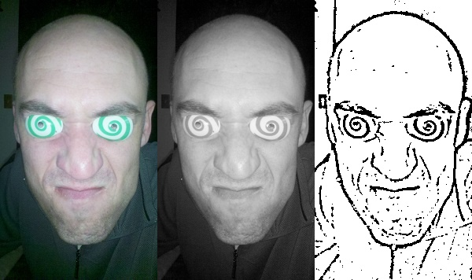
XDoG

Slide 7
Painterly Style
Implement with a variety of parameters
Brush Sizes
Difference threshold values
Scaling of Stroke curvature
I would also like to implement this on Movie files
There are also several additional styles the paper suggests that I would like to include

Slide 8
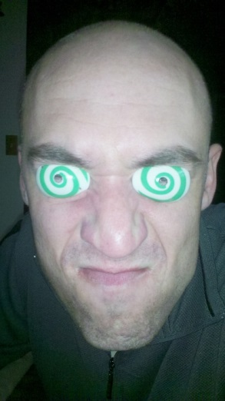
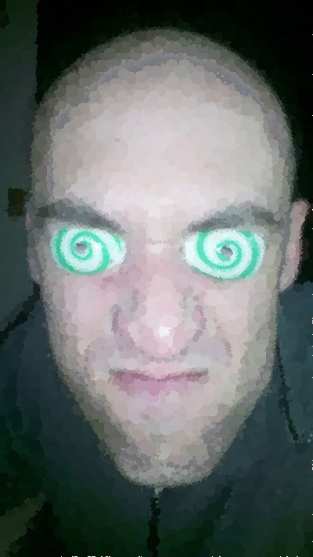

Slide 9
Salient Greyscale Conversion
Not Yet start
Still undecided on which paper I would like to implement
Color2Gray: Salient e-Preserving Color Removal
Slow on larger images
Robust color-to-gray via nonlinear global mapping
Faster but results are not as impressive

Slide 10
Salient Greyscale Conversion
Addition parameters available for this as well
Generate monotone images as well as just greyscale
Exclude Regions from greyscale conversion
Not sure if I can make this happen in the time I have

Slide 11
Conclusion
All current progress has been done with a simple command line interface.
A user interface will be added later

